Slide 1

Natural Language Processing: Introduction to NLP
Mina Farmanbar
Associate Professor, University of Stavanger
for engineers

Slide 2
What is Text Mining?
Text Mining/Text Analysis id the process of deriving meaningful information from natural language text and the evaluating and interpreting the output

Slide 3
Applications of Text Mining?
Natural Language Processing (NLP)
Text Classification
Sentiment Analysis
Language Translation
Information Extraction
Topic Modeling

Slide 4
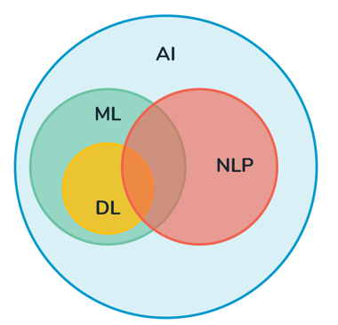
Natural Language Processing (NLP)
Linguistics
Interaction between AI, ML, NLP and human language.

Slide 5
Text Processing in NLP
Removing special characters, punctuation, and numerical values.
Converting text
to lowercase to standardize the text format.
Removing stop words (commonly occurring words such as "the," "is," "and") that carry little semantic meaning.
Tokenization
to split text into individual words or phrases.
Stemming and lemmatization
to reduce words to their base or root forms.

Slide 6
Feature Extraction in NLP
Bag of Words (BoW):
Representing text as a matrix of word frequencies or presence/absence indicators.
Term Frequency-Inverse Document Frequency (TF-IDF):
Assigning weights to words based on their frequency in a document relative to their frequency across the entire corpus.
Word Embeddings:
Representing words as dense vectors in a continuous vector space, capturing semantic relationships between words.

Slide 7
NLP Libraries and Tools
NLTK (Natural Language Toolkit)
SpaCy
TextBlob
Transformers (Hugging Face)
TensorFlow Text

Slide 8
NLTK: Most popular Python Library for NLP
NLTK stands for natural language tool kit.
It is powerful Python library, specifically designed for working with human language data, which is often referred to as natural language processing.

Slide 9
Setting the NLTK Environment
Install Python
Install NLTK
pip install nltk
Install NLTK data
import nltk
nltk.download()
NLTK comes with variety of datasets and resources.

Slide 10
Thank you!
Mina Farmanbar
mina.farmanbar@uis.no

